Slide 1

Forest fires: BURNED AREA PREDICTION MODELS
Presented by:
Siddhartha Chilukuri
Vigneshwar Lokoji
DASC 5302.001
Dr. Lei Jin

Slide 2
Introduction
Forest fires pose a significant threat to ecosystems and human life. Accurate prediction of burned area can aid in early detection, prevention, and resource allocation.
Goal is to predict the burned area (area) based on weather indices, temperature, humidity, and other environmental factors.

Slide 3
About the data set
Spatial Coordinates (X, Y): Geographic location of the fire incident.
Temporal Features (Month, Day): Month and day of the fire occurrence.
Meteorological Factors:
FFMC (Fine Fuel Moisture Code): Relative humidity of litter and other cured fine fuels.
DMC (Duff Moisture Code): Moisture content of decomposed organic layers.
DC (Drought Code): Drought code representing the moisture content of deeper soil layers.
ISI (Initial Spread Index): Index indicating the initial rate of spread of fire.
Temp: Temperature.
RH: Relative humidity.
Wind: Wind speed.
Rain: Rainfall.
Target Variable (Area): The burned area in hectares.

Slide 4
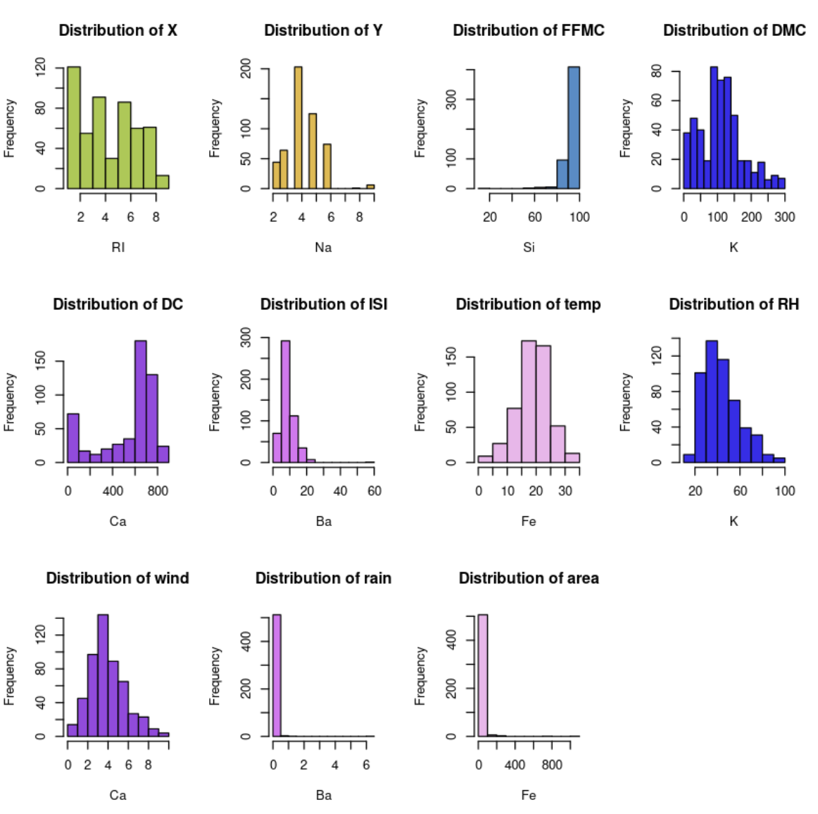
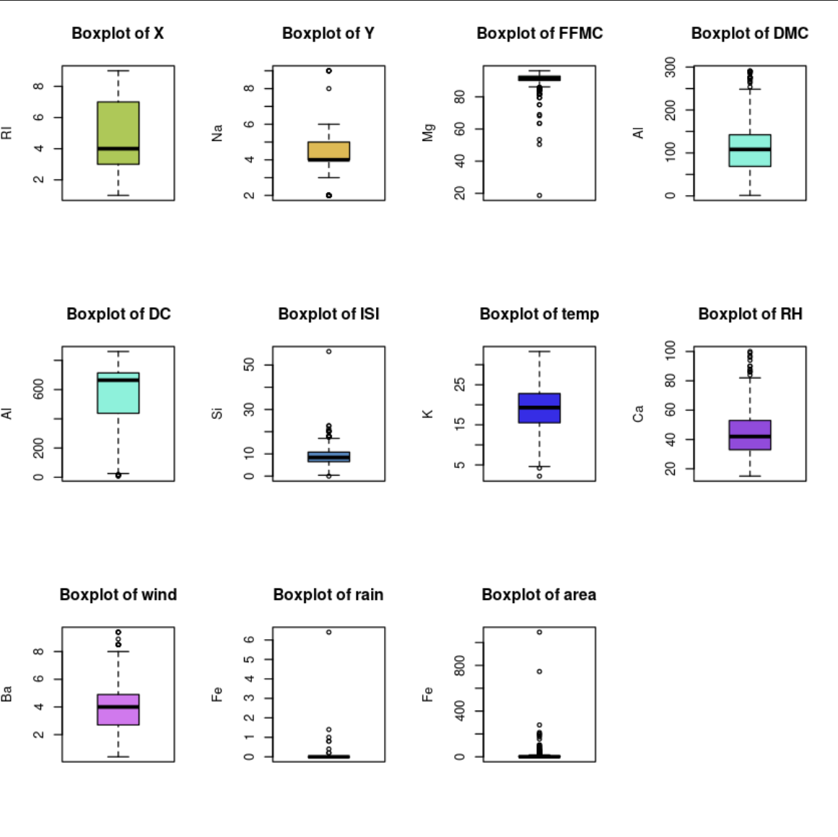
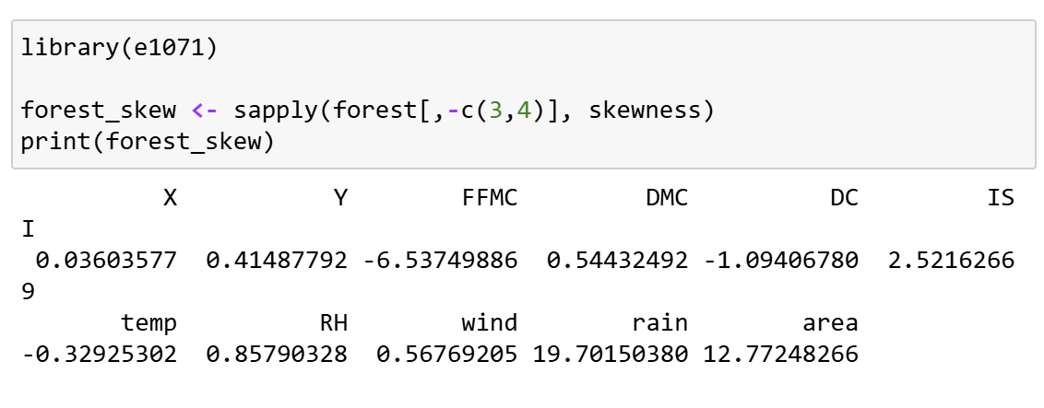
Exploratory data analysis

Slide 5
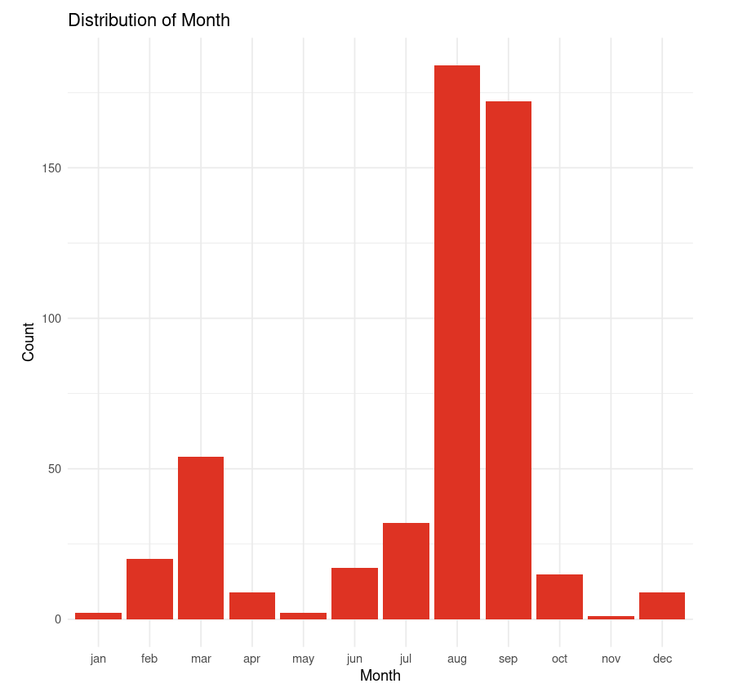
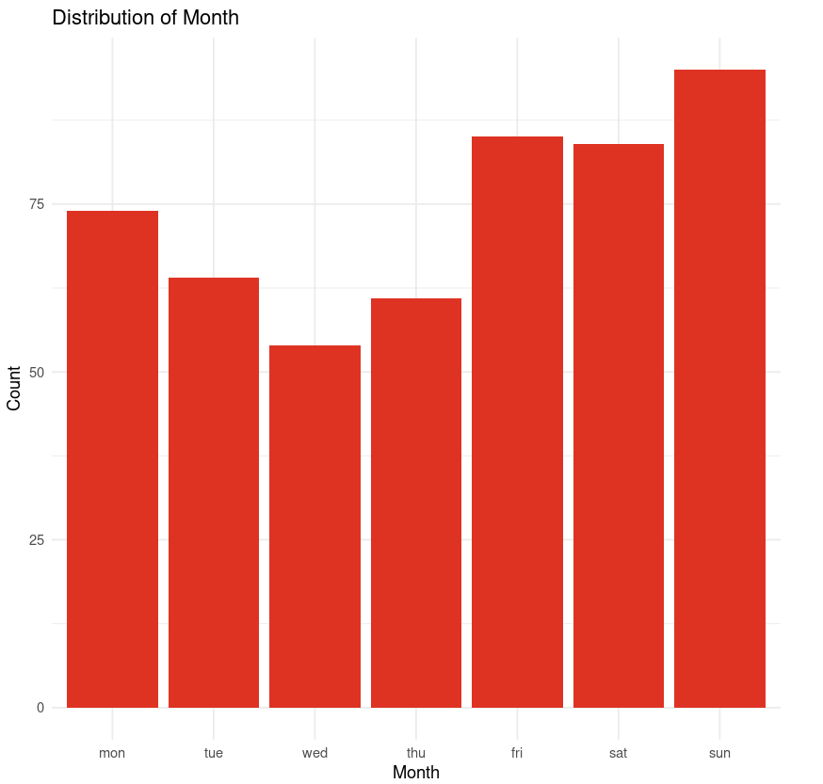
Distribution of data across month

Slide 6
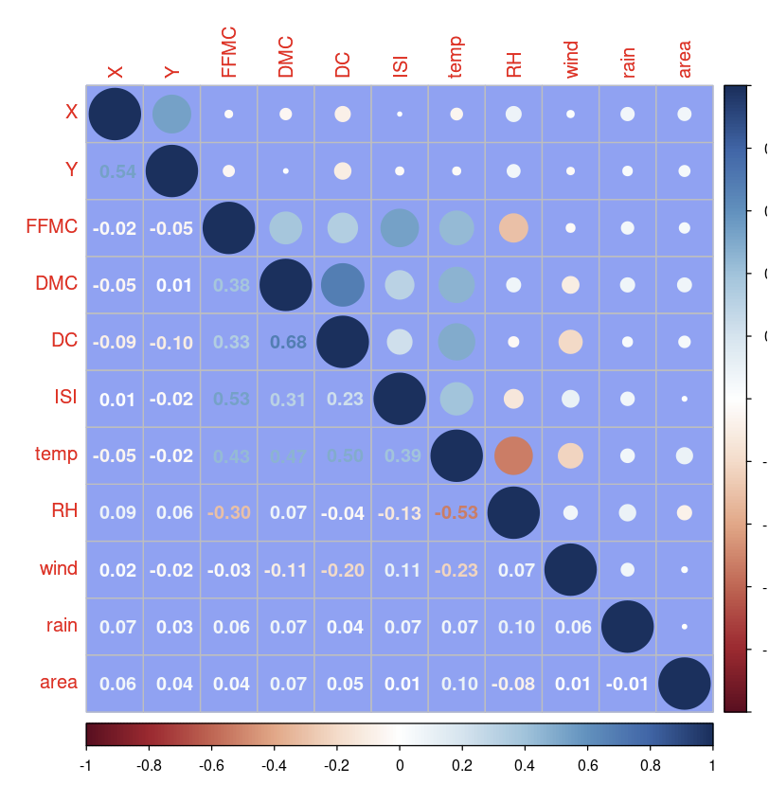
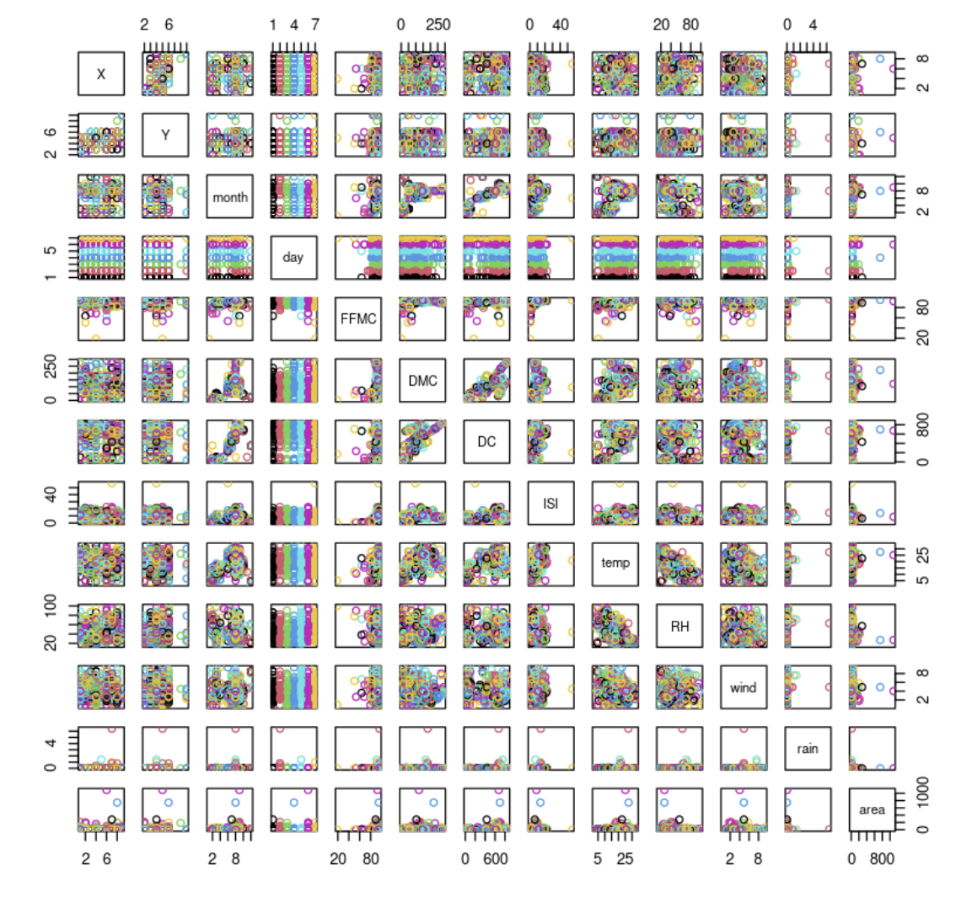
Correlation plot

Slide 7
Transformations
X – No transformation
Y- No Transformation
FFMC – Spatial sign, winsorization
DMC – No Transformation
DC – Spatial sign, winsorization
ISI – Box-Cox, Winsorization
Temp – No Tranformation
RH – Box-Cox
Wind – No Tranformation
RAIN – Spatial sign, winsorization
AREA – Spatial sign, winsorization

Slide 8
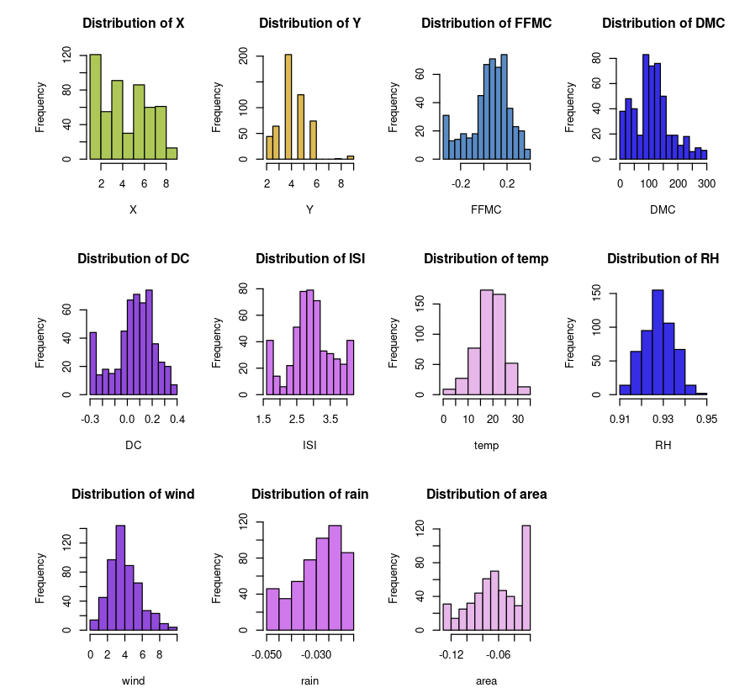
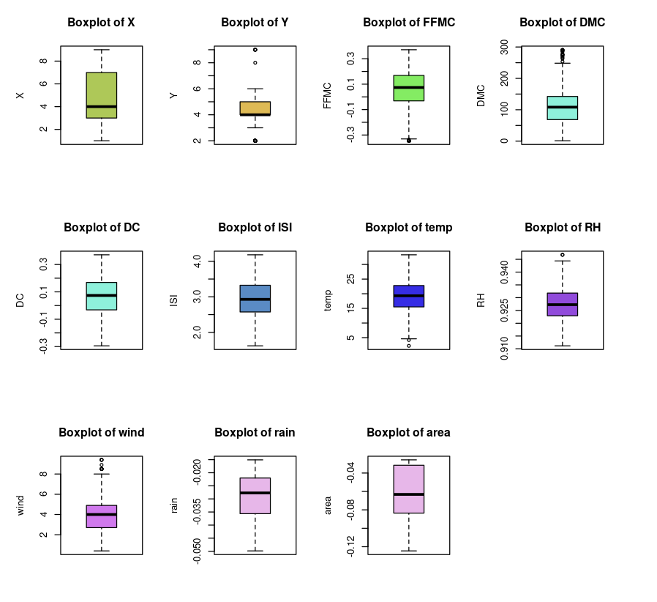
visualizations

Slide 9
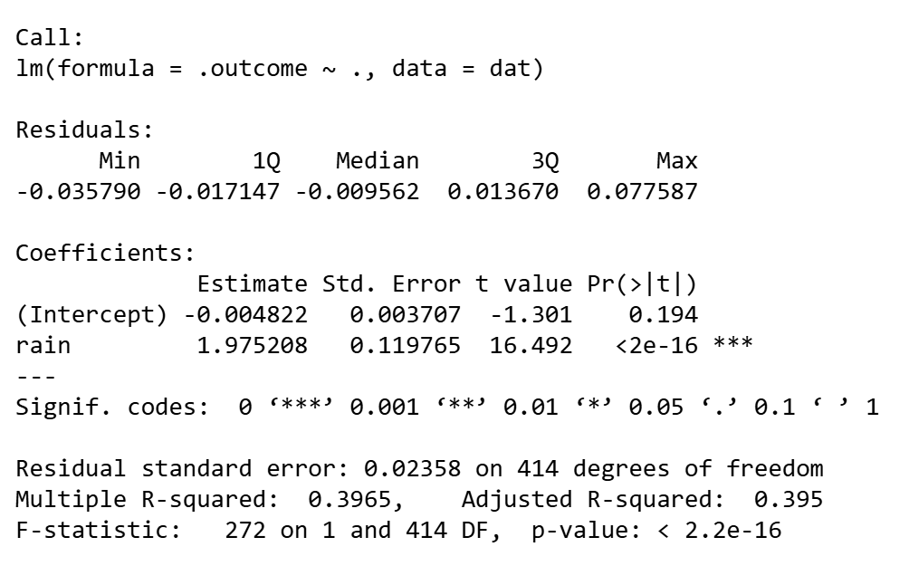
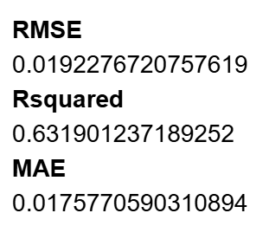
Linear Model
Linear Regression:
Used AIC for identifying the suitable response variable “Rain”

Slide 10
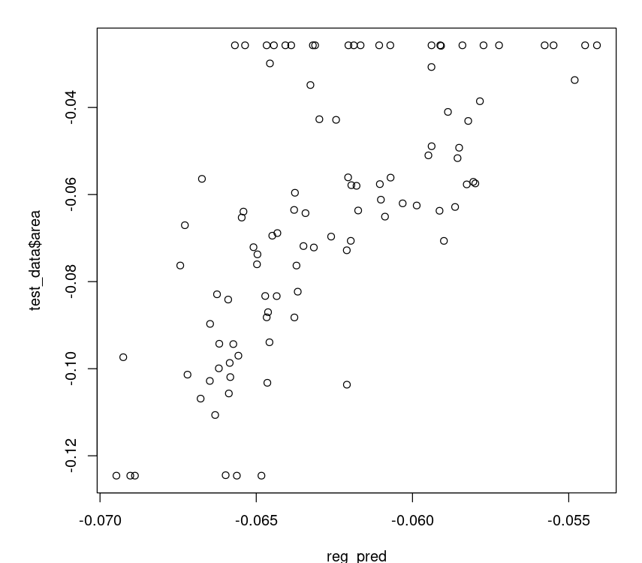
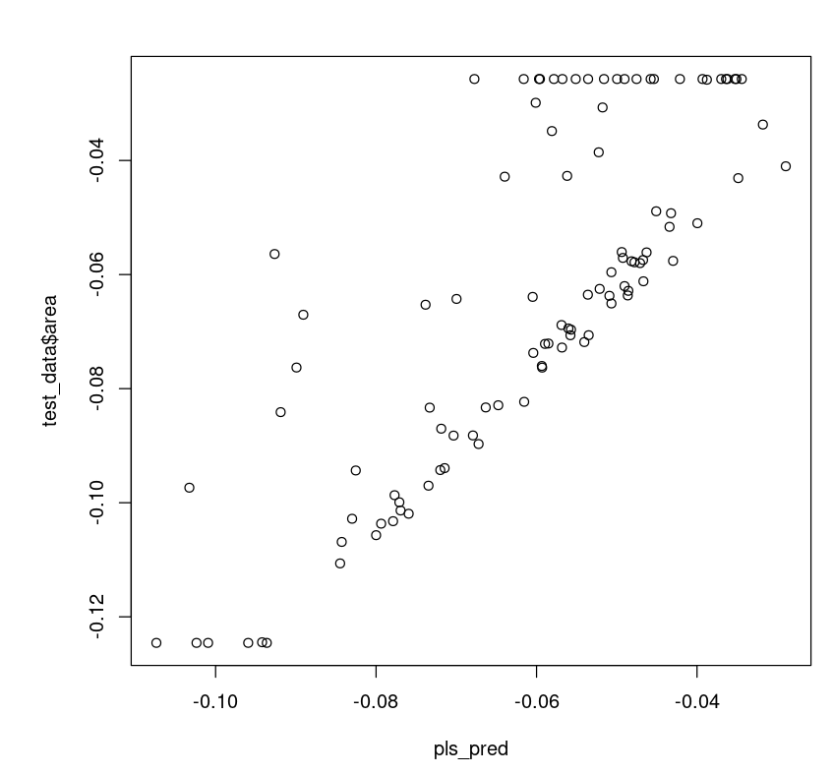
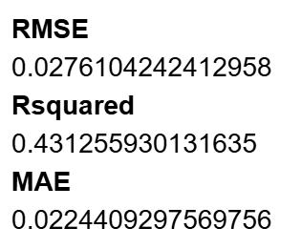
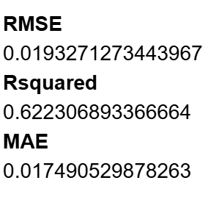
Linear model
PARTIAL LEAST SQUARES REGRESSION
REGULARIZATION MODEL (LASSO)

Slide 11
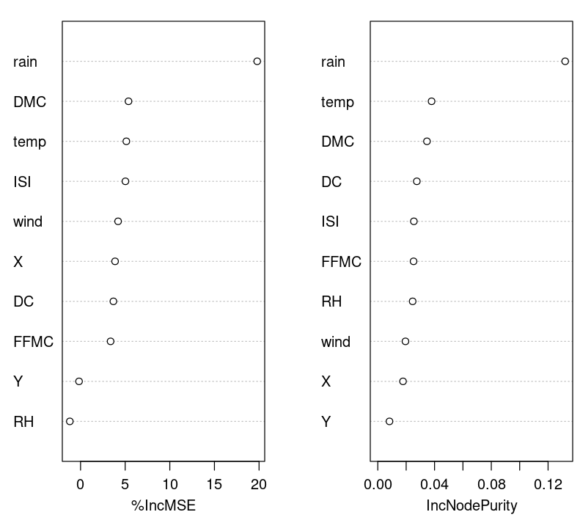
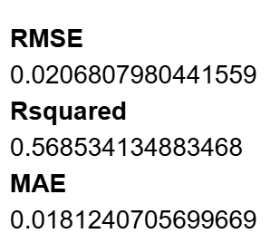
Non linear
RANDOM FOREST

Slide 12
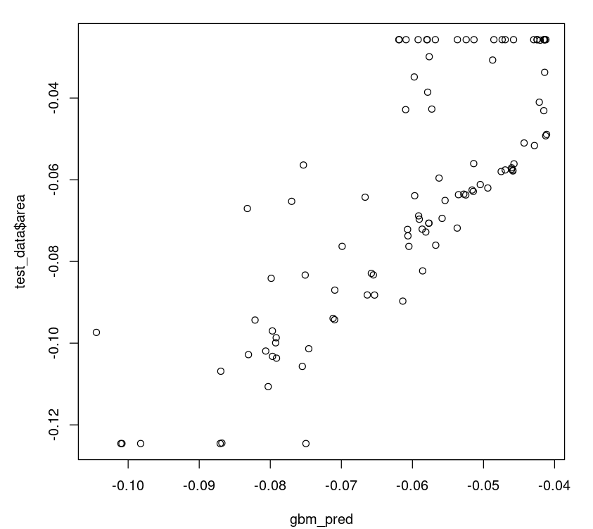
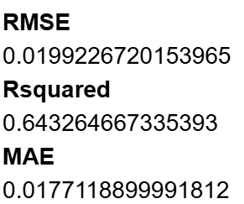
Non linear
Gradient Boosting Machines

Slide 13
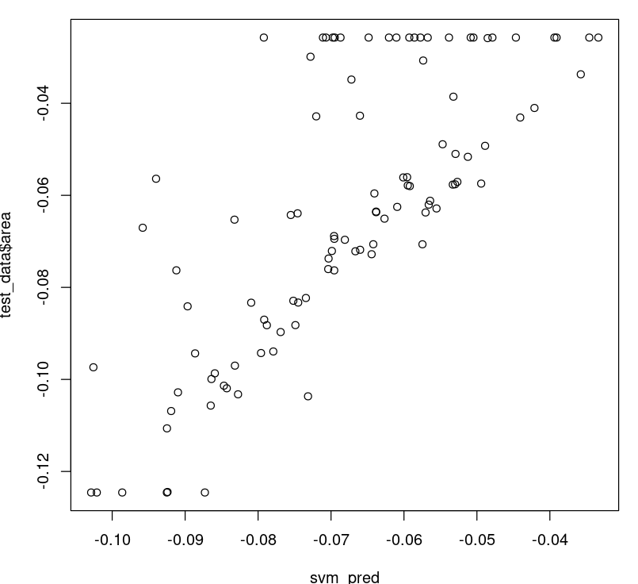
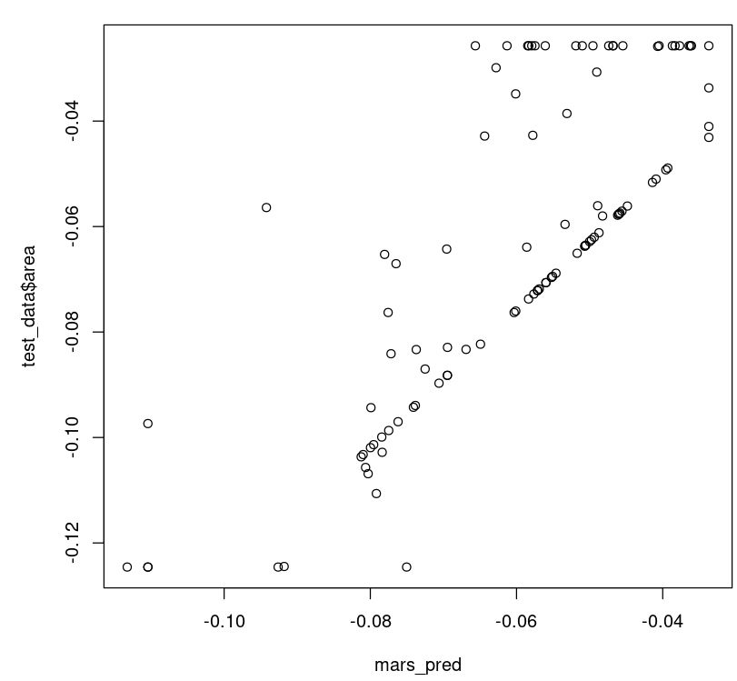
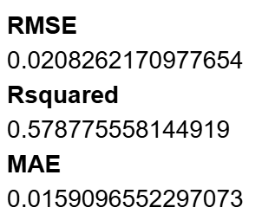
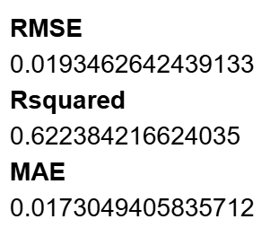
Non linear
SVM
MARS

Slide 14
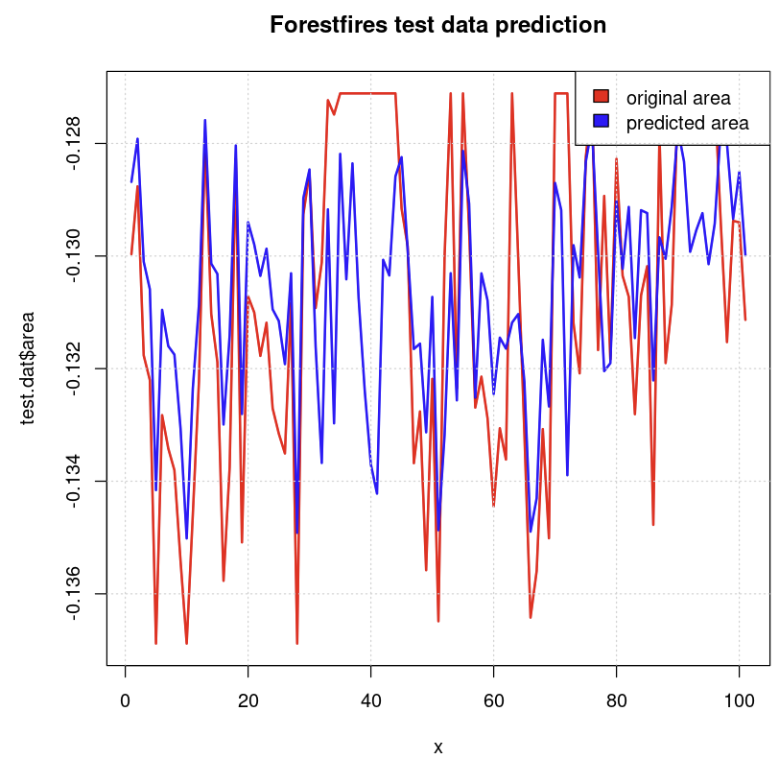
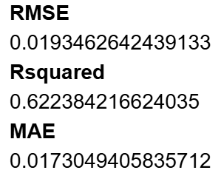
Non linear
NEURAL NETWORKS
(ensamble methods-avNNet)
KNN REGRESSION

Slide 15
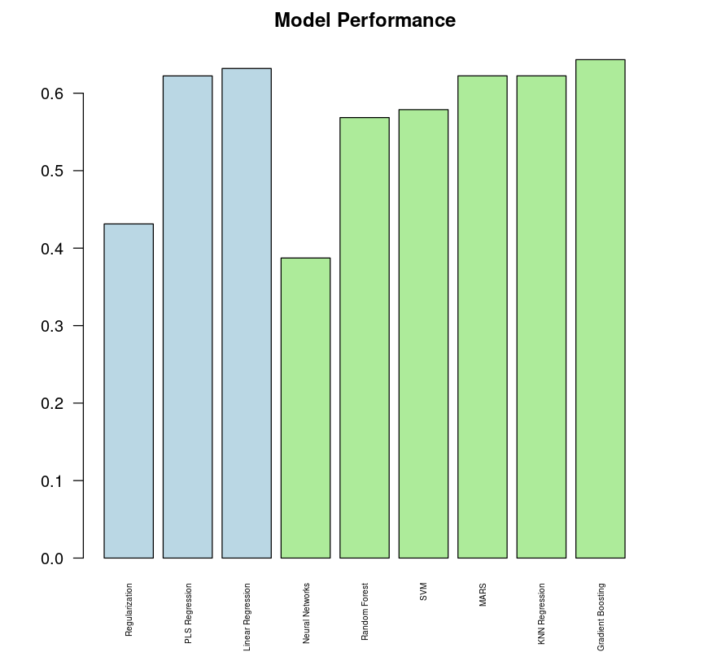
rESULTS

Slide 16
Thank You!

